Slide 1
How to Create a CMS Page in Magento 2 and Add it’s Link to Top Navigation Menu
How to create a CMS page and then add its link to top menu navigation?
Obviously there is a quick solution or rather a turnaround for this where you can just create a CMS Block->Add content in there from the page->Save and then in Products->Categories->Design tab->Select that Static block.

Slide 2
With this you can show the content in category but cannot get the desired page content on the specific URL you want to use on your Magento eCommerce store.
But now you can put your own custom link in the main category navigation menu using the guide we have provided in this blog post

Slide 3
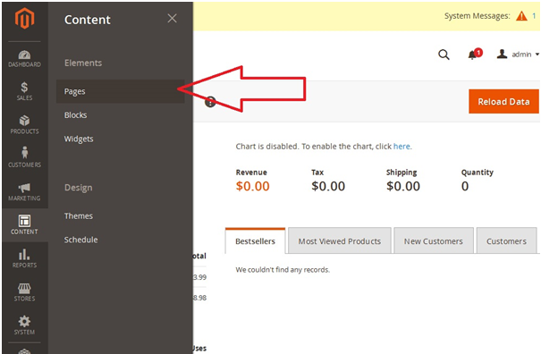
Create a CMS Page
Let’s start with creating the CMS page you want to add in navigation top menu. Go to Admin -> Content -> Pages

Slide 4
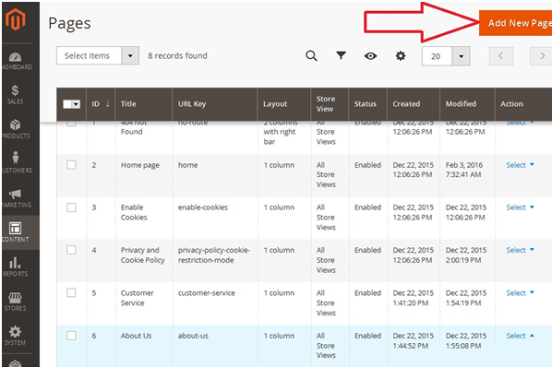
Click on Add New button to create a new page

Slide 5
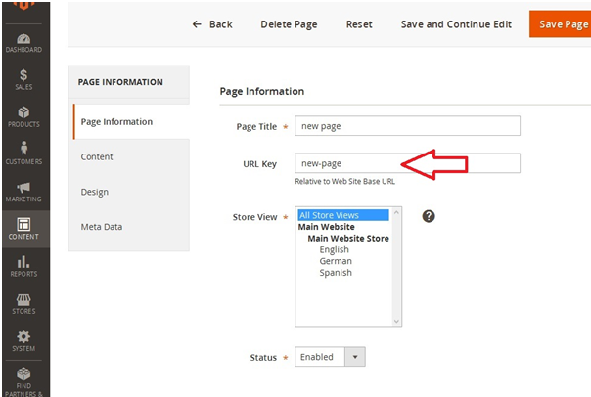
Enter details of your new page and for example let’s say page name as “new page” and please note down the URL Key specified as “new-page”. Add the content for page and click on “Save Page”.

Slide 6
Add CMS Page link to Navigation Menu
Next step for this is that you have to do customization to your theme’s XML file which will let you add your own code to specific sections of your template.
First I’m going to define a Namespace as “Mageice” and ModuleName “NavigationLink” for my extension. Create a file named “default.xml” in Magento 2 root at location
Create the following directories under app folder
App > Mageice>NavigationLink->View->frontend->layout->
Create a file called default.xml, directory should look like
app/Mageice/NavigationLink/view/frontend/layout/default.xml

Slide 7
Put below code in the created file:
<?xml version="1.0"?>
<page xmlns:xsi="http://www.w3.org/2001/XMLSchema-instance" xsi:noNamespaceSchemaLocation="urn:magento:framework:View/Layout/etc/page_configuration.xsd">
<body>
<referenceContainer name="catalog.topnav">
<block class="Magento\Framework\View\Element\Html\Link\Current" name="navigationlink">
<block class="Mageice\NavigationLink\Block\Links\Link" name="newpage" after='-' />
</referenceContainer>
</body>

Slide 8
Now you need to create the file which contains the name of your link and the URL key which was noted down while you created the page. Create a file named “Link.php” at below location from Magento 2 root.
Create the following folders in app directory, and a file called Link.php
app/Mageice/NavigationLink/Block/Links/Link.php
Put below code in the created file with replacing ‘cms_page_url_key’ with your page URL Key ‘new-page’ and the page link name ‘Link_Name’ with ‘New Page’:

Slide 9
<?php
namespace Mageice\NavigationLink\Block\Links;
class Link extends \Magento\Framework\View\Element\Html\Link
{
public function __construct(
\Magento\Framework\View\Element\Template\Context $context,
array $data = []
) {
parent::__construct($context, $data);
}
public function getHref(){
$page_url = 'cms_page_url_key';
return $this->getUrl($page_url);
}
public function getLabel(){
return 'Link_Name';
}
}

Slide 10
Save both the files and clear the cache and activate extension with below command on command line with SSH access to your Magento 2 server on Document Root directory.
  php bin/magento setup:upgrade
  php bin/magento static:content:deploy
After both commands have successfully completed you can now open your website homepage and check that the link has been shown now on the Navigation Menu.

